Slide 2
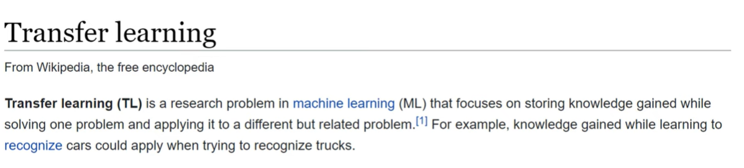
Transfer Learning

Slide 3
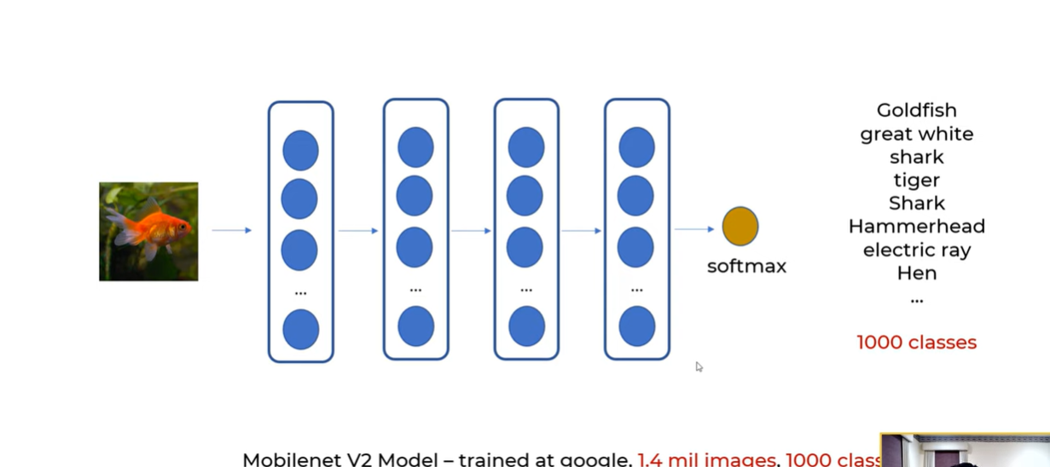

Slide 4
Deep Transfer Learning
Deep transfer learning is a machine learning technique that utilizes the knowledge learned from one task to improve the performance of another related task.
This technique is particularly useful when there is a shortage of labeled data for the target task
this is based on the idea that the lower layers of a neural network, such as the convolutional layers, learn general features that are useful for a wide range of tasks, while the higher layers learn task-specific features.
By fine-tuning the weights of the higher layers, a model can be adapted to a new task while retaining the general features learned from the original task.

Slide 5
Reasons to use deep transfer learning:
It can improve the performance of a model on a new task by leveraging the knowledge learned from the pre-trained model.
It can save time and resources by avoiding the need to train a model from scratch.
Furthermore, it can be useful when there is limited labeled data available for a new task.
Besides, it can be used to transfer knowledge from one domain to another.
It can be used to improve the performance of a model on a low-resource language or task.

Slide 6
Main Approaches in Deep transfer learning
Deep transfer learning is a technique that utilizes pre-trained deep neural networks as the starting point for training on a new task. There are several different types of algorithms used in deep transfer learning, including:
Fine-tuning: This involves taking a pre-trained network and training it further on a new task by adjusting the weights of the final layers.
Feature extraction: This method uses the features learned by a pre-trained network as input to a new classifier, which is trained from scratch.
Multitask learning: This approach trains a single network on multiple tasks simultaneously, allowing the network to learn shared representations that can be useful for all tasks.
Domain adaptation: This method aims to adapt a pre-trained network to a new domain, by aligning the feature representations of the source and target domains.
Transfer learning with GANs: This method uses generative adversarial networks (GANs) to transfer knowledge from a pre-trained network to a new task by training a generator that can produce samples similar to those from the source task.
Knowledge distillation: This method trains a smaller network to mimic the behavior of a larger, pre-trained network, effectively transferring the knowledge from the larger network to the smaller one.
Transfer learning with meta-learning: this method uses meta-learning to learn how to learn from different tasks and transfer the knowledge to new tasks.

Slide 7
Steps involved:
Initialize the pre-trained model with weights from a model trained on a large dataset.
Replace the final layer(s) of the pre-trained model with new, untrained layers that are specific to the task at hand.
Fine-tune the weights of the pre-trained model by training it on the new task, using a smaller dataset.
Optionally, repeat step 3 with different learning rates or by unfreezing more layers of the pre-trained model.
Use the fine-tuned model for the prediction of new data.

Slide 8
Difference between deep transfer learning and transfer learning:
Transfer learning is a technique in which a model trained on one task is used as a starting point for training a model on a different but related task.
it applies the weight of the learned feature to the new model.
The pre-trained model is typically fine-tuned with a smaller dataset to improve its performance on the new task.
Transfer learning is a general technique that can be applied to any type of model, such as traditional machine learning models like decision trees, random forests, and support vector machines or deep neural networks.
Deep transfer learning, on the other hand, specifically refers to the use of deep neural networks (DNNs) in transfer learning. In deep transfer learning, a pre-trained deep neural network model is fine-tuned for a different task, leveraging the knowledge learned from the pre-trained model. This can be done by fine-tuning the last few layers of the model, and/or by fine-tuning the whole model.
In summary, transfer learning is a general concept that can be applied to any type of model, while deep transfer learning specifically refers to the use of pre-trained deep neural networks in transfer learning.

Slide 9
Applications:
Deep transfer learning is widely used in Natural Language processing and computer vision tasks. One of the most popular applications of deep transfer learning is in computer vision, where it is used to pre-train a model on a large dataset, such as ImageNet, and then fine-tune it on a smaller dataset for a specific task, such as object detection or image segmentation. This approach has been used to achieve state-of-the-art results on a wide range of computer vision tasks. Another application of deep transfer learning is in natural language processing, where pre-trained language models, such as BERT and GPT-2, have been fine-tuned for tasks such as sentiment analysis and question answering. These models have been shown to achieve state-of-the-art results on a wide range of NLP tasks and have been widely adopted by industry and academia. In addition to computer vision and natural language processing, deep transfer learning has been applied to other areas such as speech recognition, reinforcement learning, and generative models.
Advantages:

Slide 10
Advantages:
Deep transfer learning has several advantages over traditional machine learning and training deep neural networks from scratch:
Improved performance: Deep transfer learning can improve the performance of a model on a new task by leveraging the knowledge learned from the pre-trained model. This is because deep neural networks have many parameters and are able to learn complex representations of data, so they can be fine-tuned to perform well on a new task.
Reduced training time: It can save time and computational resources by avoiding the need to train a model from scratch.
Handling limited data: It can be useful when there is limited labeled data available for a new task, as the pre-trained model can provide a good starting point for fine-tuning.
Cross-domain knowledge transfer: It can be used to transfer knowledge from one domain to another, by fine-tuning a pre-trained model on a new task in a different domain.
Handling low-resource tasks: It can be used to improve the performance of a model on a low-resource language or task by fine-tuning a pre-trained model on a larger dataset in a related task or language.
Avoiding overfitting: Using pre-trained models can help avoid overfitting, as the model has already learned general features from a large dataset and can adapt to a new task with less data.
Limitations:
However, there are some limitations to deep transfer learning. If the source and target tasks are not similar enough, the model may not be able to transfer the knowledge learned from the source task to the target task. Additionally, if the model is not fine-tuned properly, it may not perform as well as a model trained from scratch. Deep transfer learning, also known as fine-tuning, can be limited by the availability of large amounts of labeled data for the target task, as well as the similarity between the source and target task. Additionally, the pre-trained model may not be well-suited for the specific task or domain, leading to poor performance. Overfitting can also occur when fine-tuning a small dataset. Another limitation is the computational cost and memory requirements of fine-tuning a large pre-trained model.

Slide 11
Future Scope of deep transfer learning:
Deep transfer learning is an area of active research, and there are many potential future applications and developments. Some potential areas of future research include:
Applying transfer learning to new and emerging domains, such as natural language generation, speech synthesis, and computer vision for self-driving cars.
Developing new techniques for fine-tuning and adapting pre-trained models to new tasks and data distributions.
Improving the efficiency of transfer learning by developing methods for selectively transferring only the most relevant knowledge from a pre-trained model.
Investigating ways to use transfer learning to improve the robustness and generalization of deep learning models, for example by transferring knowledge from synthetic data or simulated environments to real-world settings.
Overall, deep transfer learning has the potential to greatly improve the efficiency and performance of deep learning models, and is likely to play a significant role in many areas of AI research in the future.

Slide 12
Recurrent Neural Network

Slide 13


Slide 15
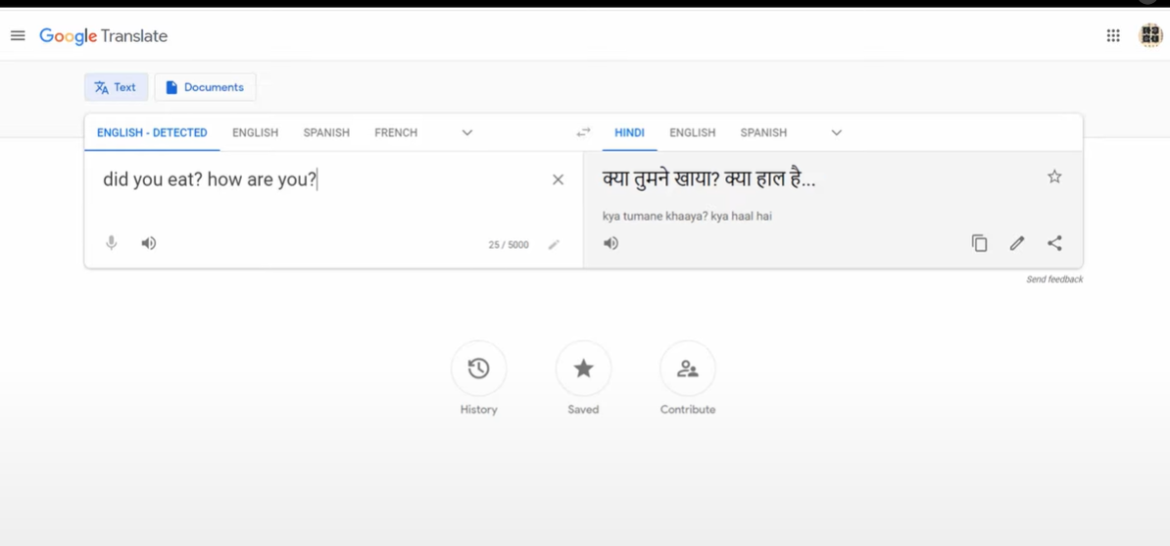

Slide 16
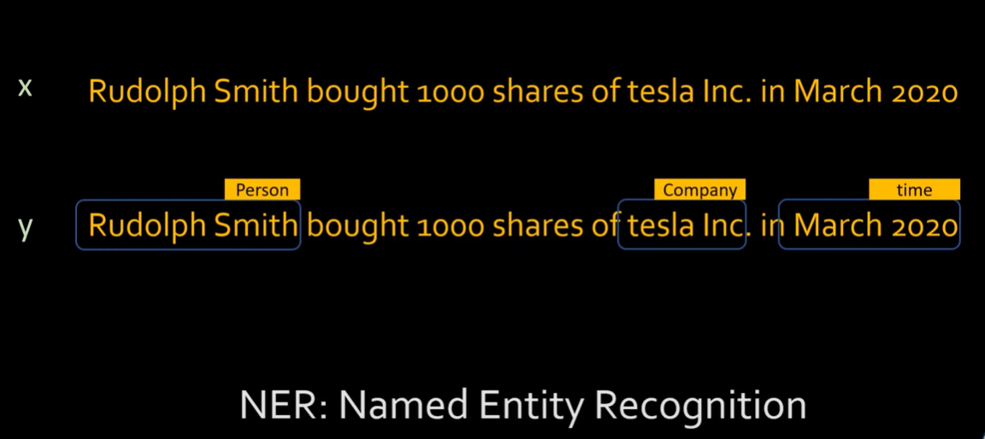

Slide 17
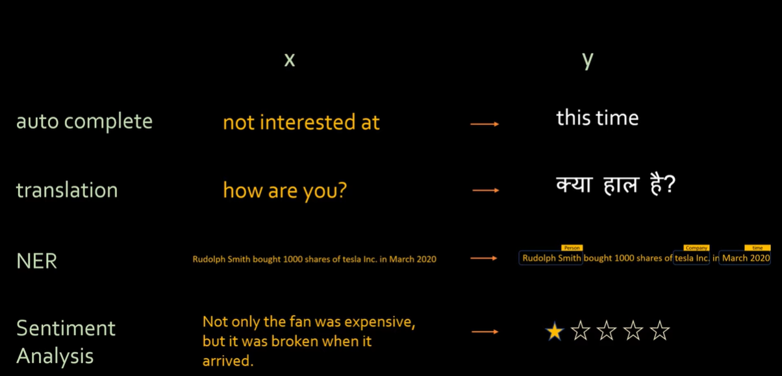

Slide 18
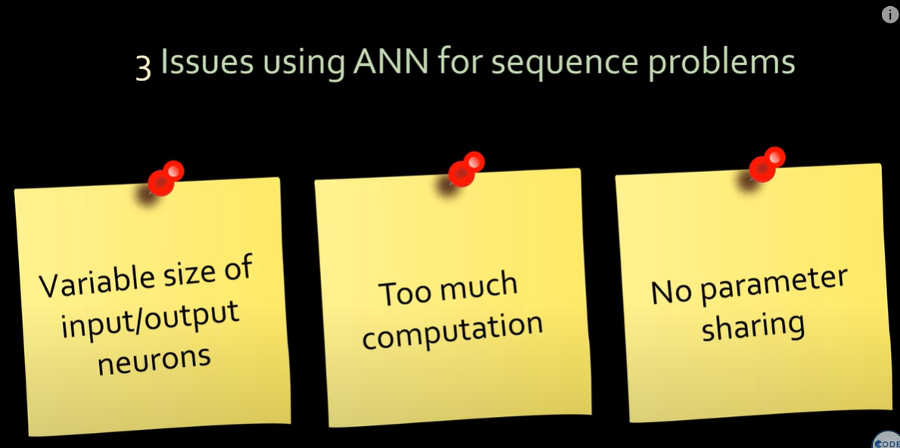

Slide 19
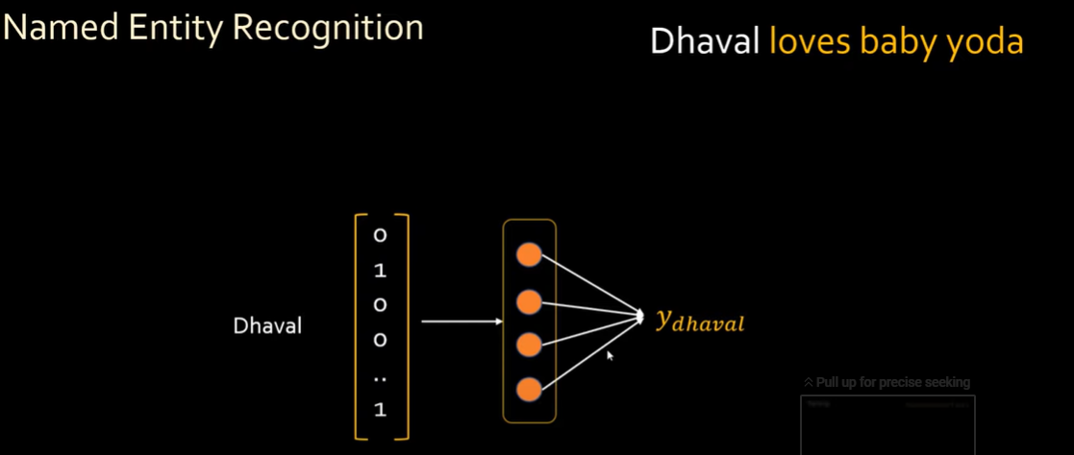

Slide 20
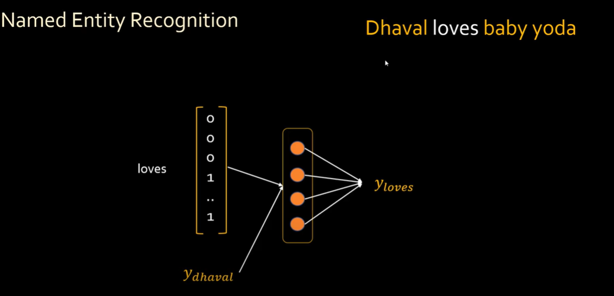

Slide 21
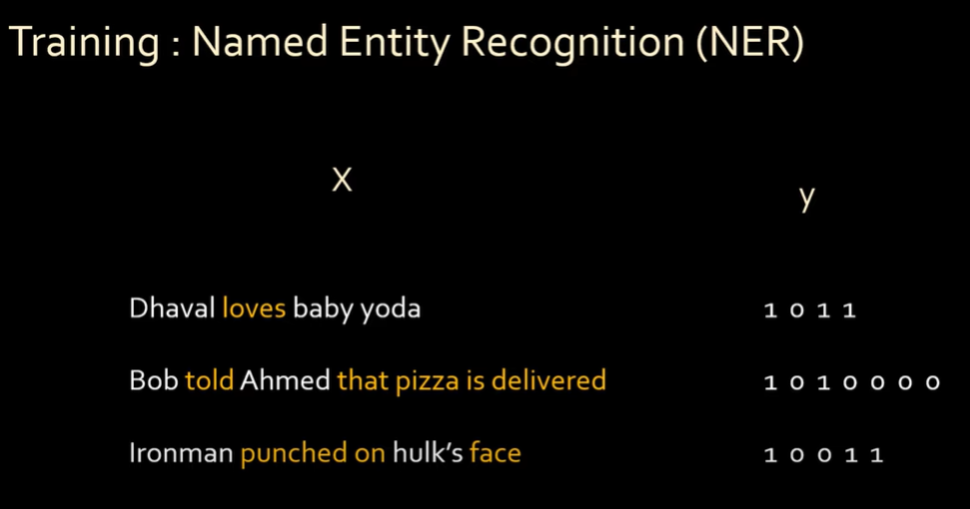

Slide 22
